Slide 1
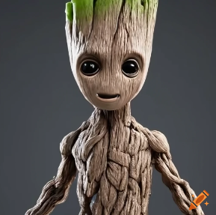
Groot
Title: Groot: The Big Hero with a Small Voice

Slide 2
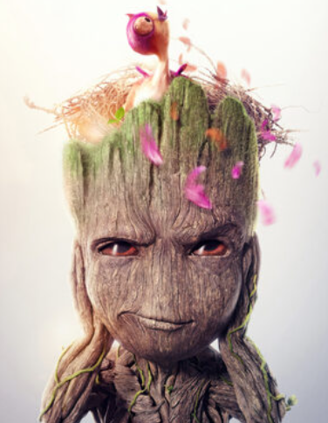
About Groot
In the big space, there is a hero named Groot. He is very different. Groot is strong and tall. His arms are long. He helps everyone.

Slide 3
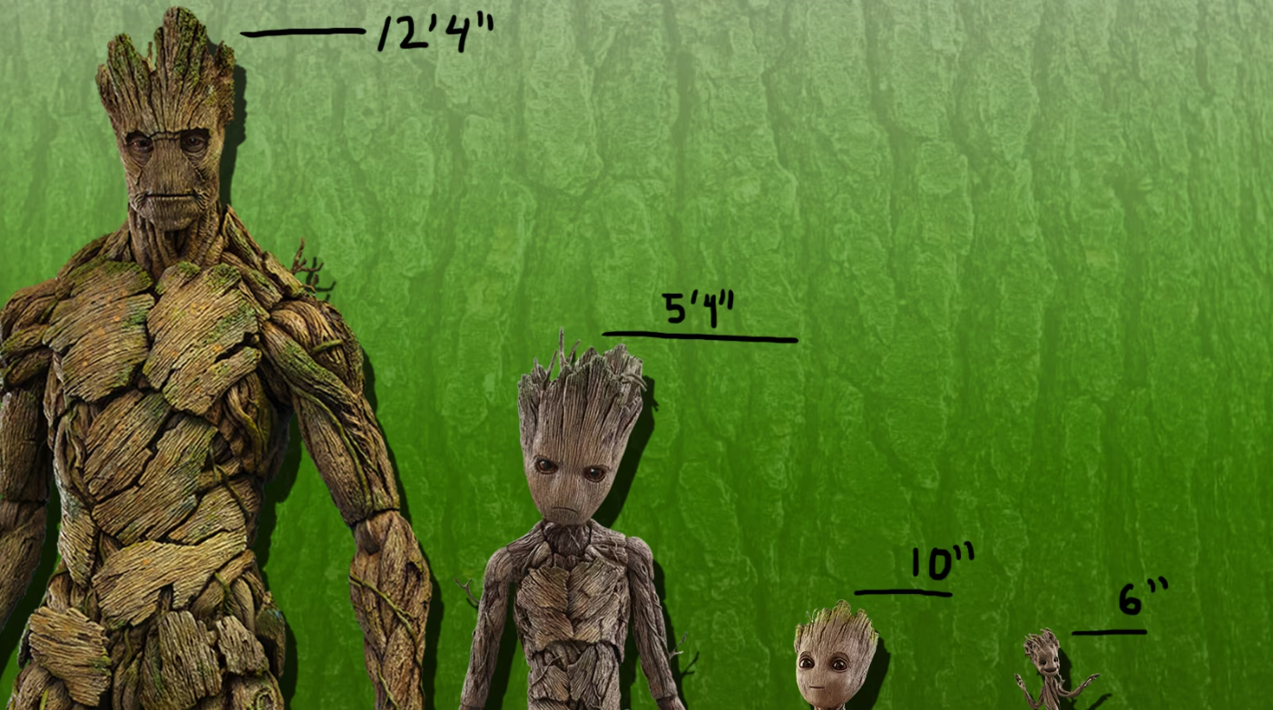
Groot doesn’t talk much. He can only say "I am Groot." But he helps a lot. He fights bad things. He helps his friends, the Guardians of the Galaxy.

Slide 4
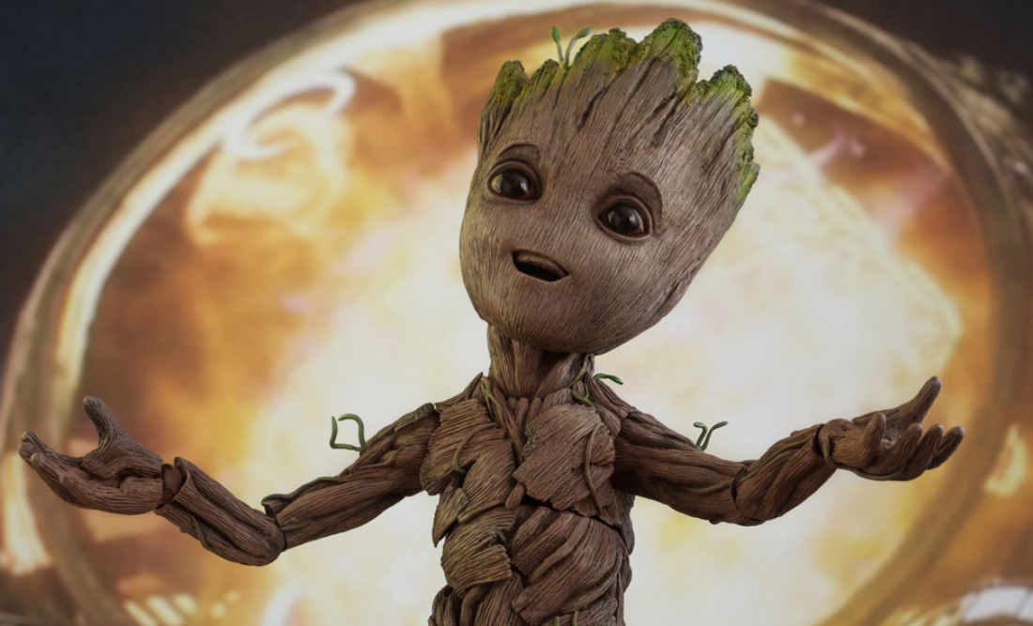
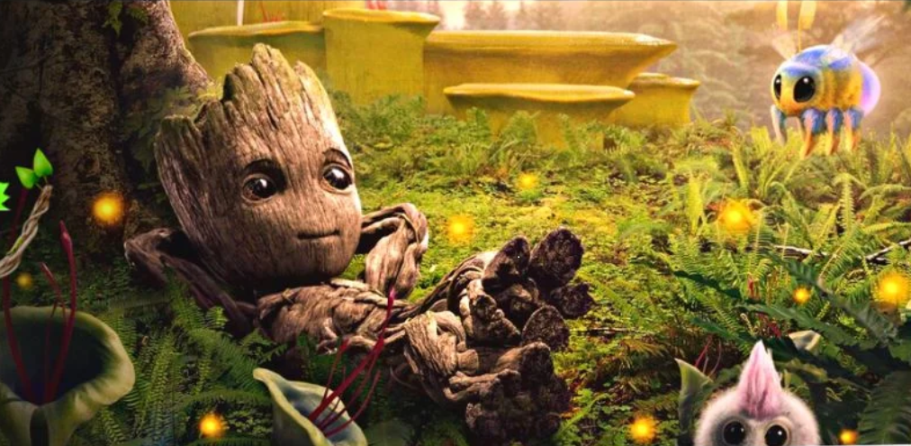
Groot is kind. He helps when someone is sad. He is always there for his friends. They travel together and help people.

Slide 5
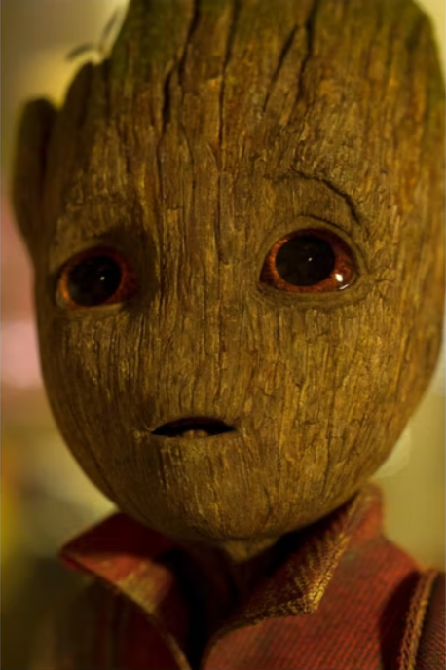
Groot is a hero. He shows that you can help in many ways. You don’t always need to talk to help. You can help just by being there.

Slide 6
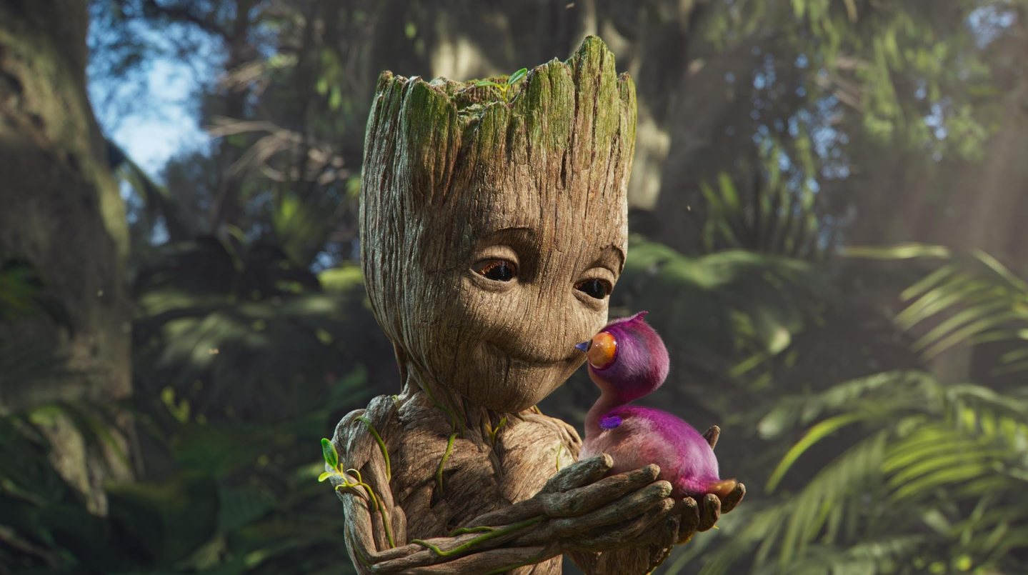
Sometimes, Groot is a little troublemaker, but his heart is always in the right place.

